Slide 1
The Pathfinder Conversation Guide will help identify your customers alignment philosophy in Total Knee Arthroplasty (TKA).
Choose an option to get started:
Start New Conversation
Start New Conversation

Slide 2
PATHFINDER Conversation Guide
Welcome!
The Pathfinder Conversation Guide will help identify your
customers alignment philosophy in Total Knee Arthroplasty (TKA).
Click 'Start' to begin.
Start

Slide 3
Are you willing to deviate from mechanical axis (0° HKA)?
Select one option:
Yes
No
Notes:
Yes= +1 KA / +1 iKA / +1 FA
No= +2 MA

Slide 4
What is your primary goal when performing Total Knee Arthroplasty (TKA)?
Select one option:
Aiming for a neutral mechanical alignment (0° HKA)
Restoring the patient’s native alignment to its pre-disease state
Prioritizing balanced flexion and extension gaps
Notes:
Neutral mechanical alignment (0° HKA) = +2 MA
Restore native alignment = +2 KA
Prioritize balanced flexion/extension gaps = +2 FA

Slide 5
What is your preferred surgical workflow?
Select one option:
Femur-first
Tibia-first
Notes:
Femur first = +2 KA
Tibia First= +2 iKA
Guides logic and classification behind the scenes

Slide 6
When you're performing the distal femoral
resection, what are you aiming to achieve?
Select one option:
Soft tissue balance by adjusting the cut within defined boundaries
A cut that is perpindicular to the mechanical axis of the femur
Restoration of native joint line obliquity– the femoral resection is positioned to restore the joint line to the patient's pre-arthritic anatomy.
Notes:
Balance gaps (adjust within boundaries) = +1 FA / +1 iKA
Perpendicular to mechanical axis =+2 MA
Restore native joint line = +2 KA

Slide 7
When you're performing the tibial resection,
what are you aiming to achieve?
Select one option:
Adjust the cut within boudaries to help balance the flexion and extension gaps.
Make the cut perpendicular to the mechanical axis of the tibia.
Retoration of the native joint line obliquity based on the patient's pre-arthritic anatomy.
Notes:
Balance gaps (adjust within boundaries) = +1 FA / +1 iKA
Perpendicular to mechanical axis = +2 MA
Restore native joint line = +2 KA

Slide 8
When balancing extension gaps, the priority is:
Select one option:
Minimize tibial varus -prioritizes neutral tibia, adjusts femur component to balance extension gaps.
Minimize femoral joint line deviation–prioritizes native femur joint line, adjusts tibia component to balance gaps
Evenly distribute changes to femur/tibia –prioritizes neutral femur and tibia, splits varus/valgus adjustments between both components to balance gaps.
Notes:
Minimize tibial varus = +2 MA
Minimize femoral joint line deviation = +2 KA
Evenly distribute changes = +2 FA

Slide 9
The posterior femoral resection should:
Select one option:
Restore both medial and lateral posterior condylar offsets– both medial and lateral posterior resections aim to recreate the pre-arthritic posterior condylar offset.
Restore medial posterior condylar offset and use lateral resection to balance– the medial posterior resection recreates the pre-arthritic medial posterior condylar offset, and the lateral posterior resection is used to balance gaps.
Use both medial and lateral resections to balance– both medial and lateral posterior resections are used to balance gaps to obtain the intended ligament tension.
Notes:
Restore both medial/lateral offsets = +2 KA
Restore medial offset, lateral used for balance = +2 iKA
Both medial and lateral used to balance = +2 FA

Slide 10
Do you apply coronal boundaries (limits to deviation)?
Select one option:
Yes
No
Notes:
Yes =+1 iKA / +1 FA
No = +2 KA

Slide 11
Determining suggested TKA alignment philosophy…
Notes:
J&J Branded, animated transition.

Slide 12
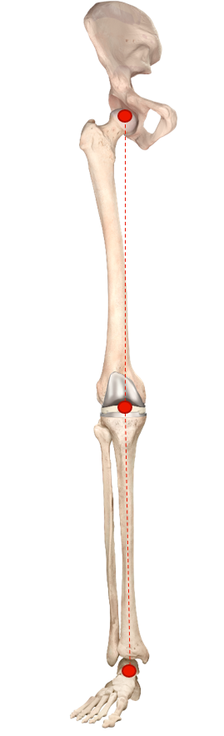
Mechanical Alignment (MA)
Your approach suggests: Mechanical Alignment (MA)
Restart
Mechanical Alignment with balancing starts off with standard mechanical alignment that aims for a neutral HKA. The femur position is then adjusted to balance flexion and extension gaps. The tibia proximal resection depths are then adjusted if needed. This technique prioritizes minimizing femur and tibia deviation from neutral.

Slide 13
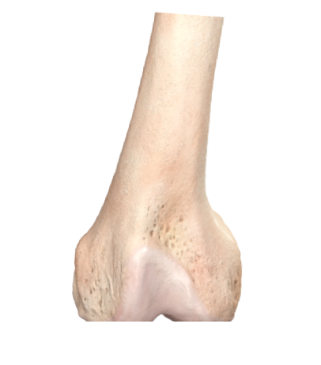
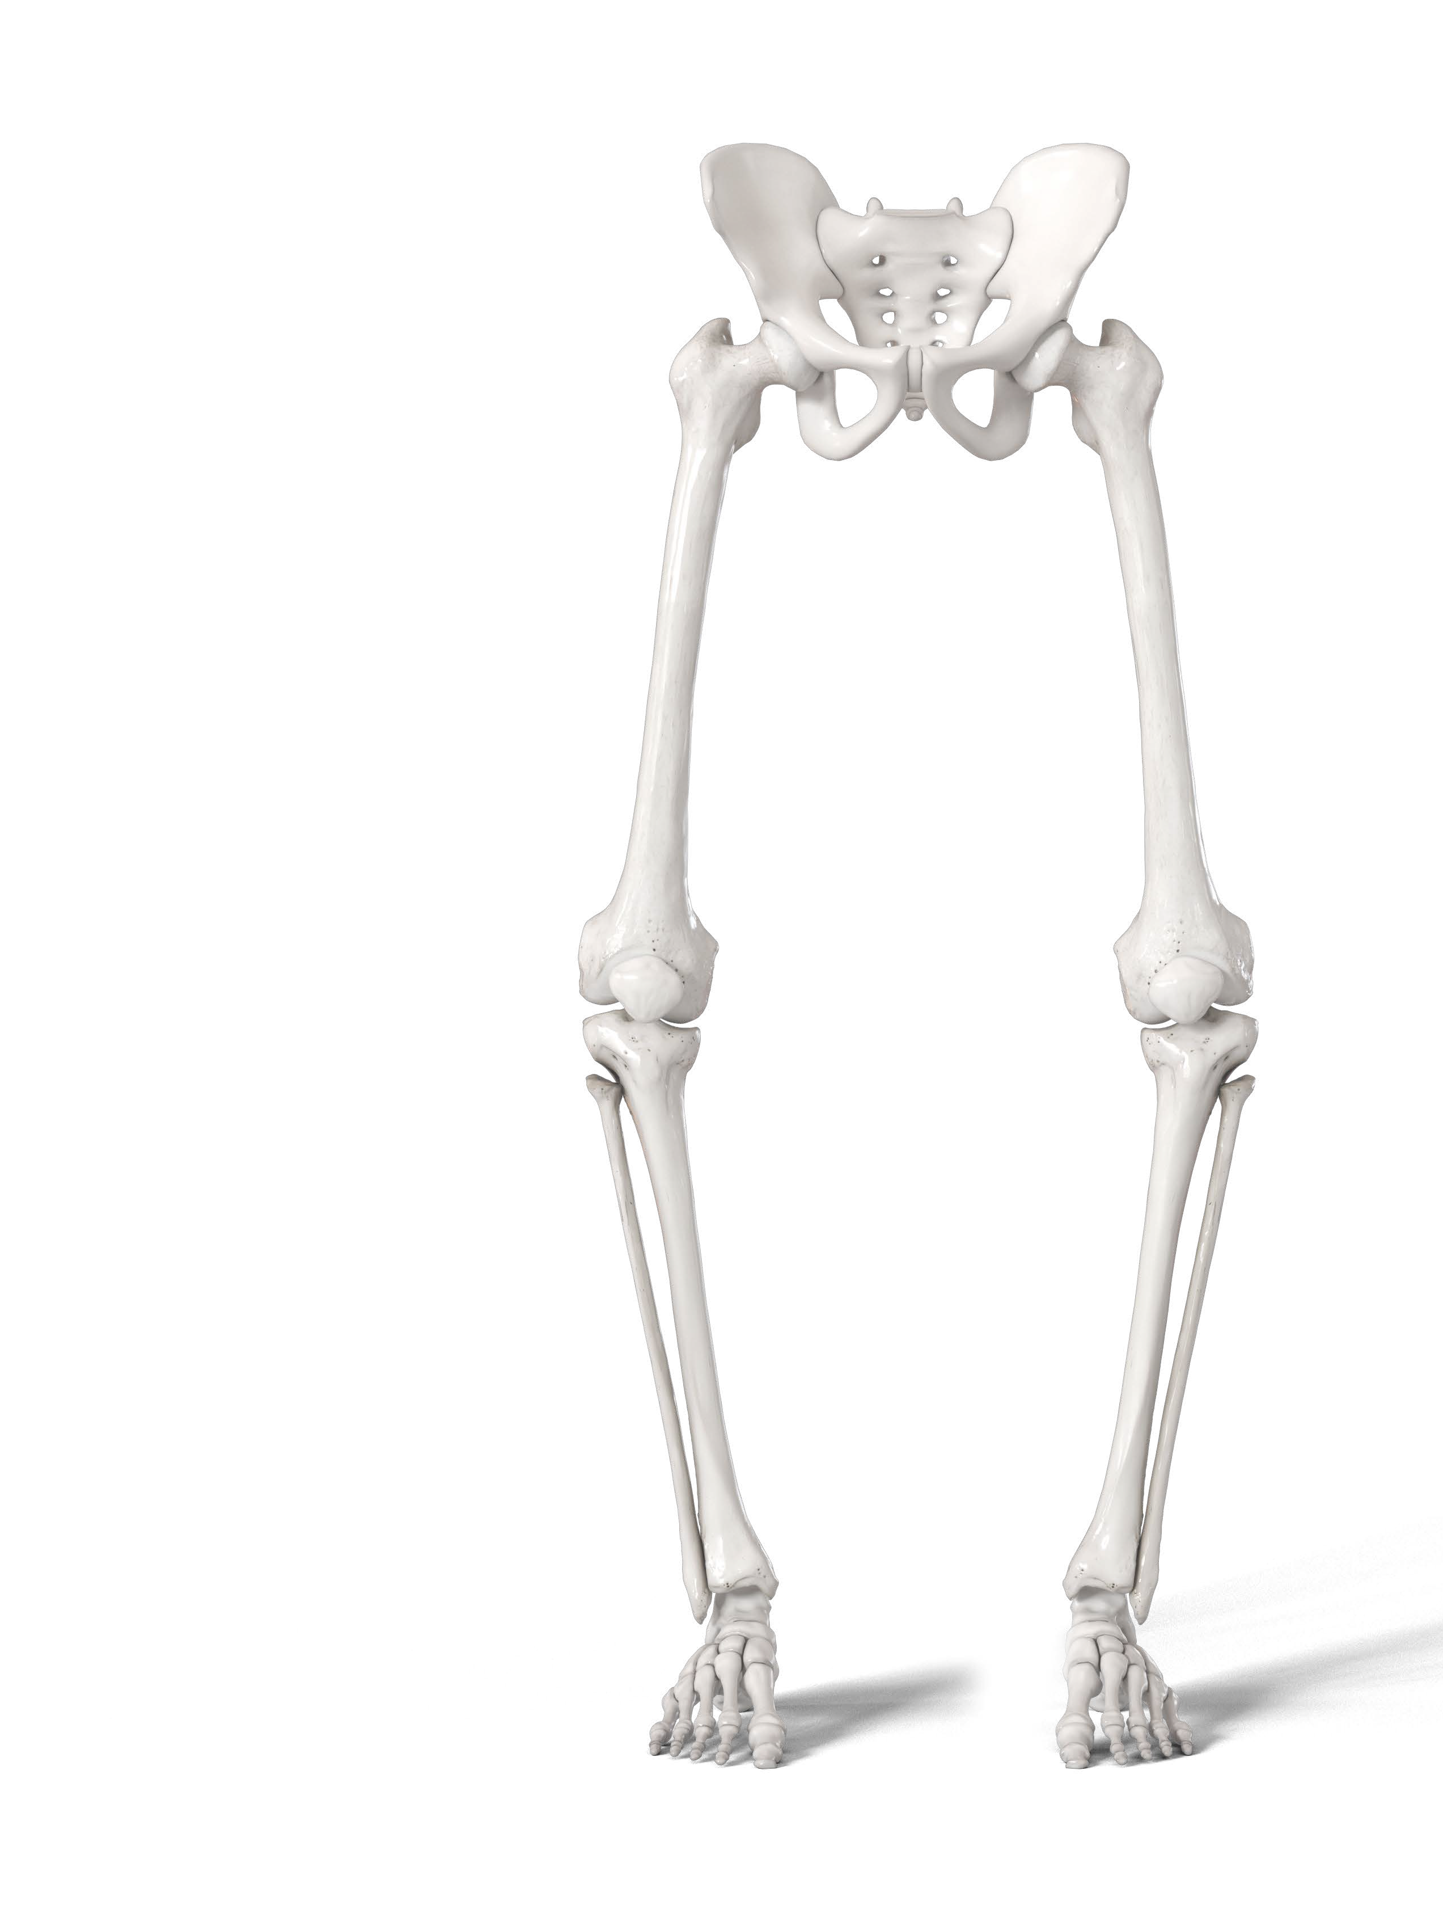
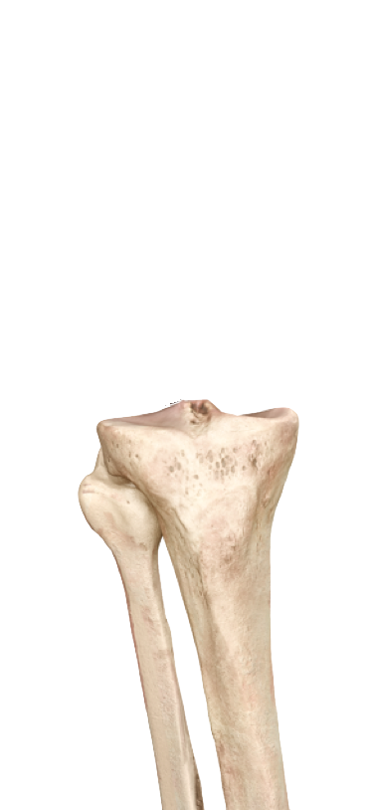
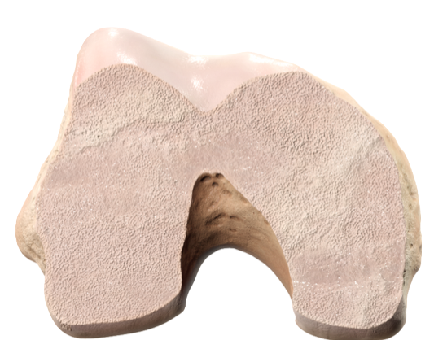
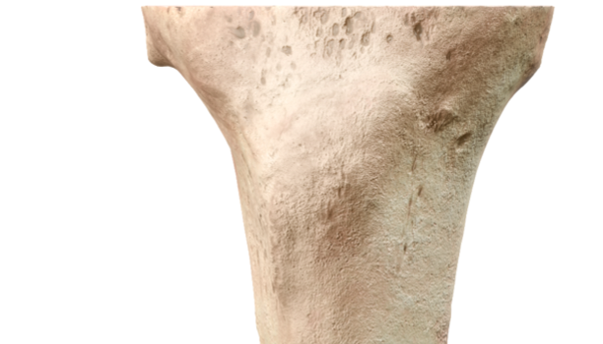
Kinematic Alignment (KA)
Your approach suggests: Kinematic Alignment (KA)
Restart
1.
Kinematic Alignment prioritizes restoring the native joint line. The femur is resurfaced first. Next, the tibia is resurfaced. Femoral and tibial resection depths are planned as the implant thickness minus the estimated cartilage and bone wear values.
2.
0°

Slide 14
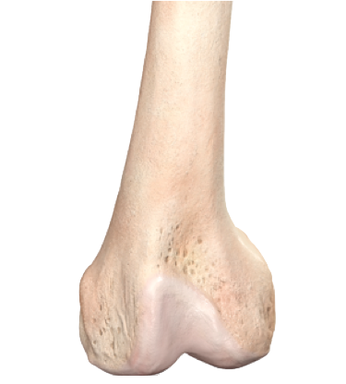
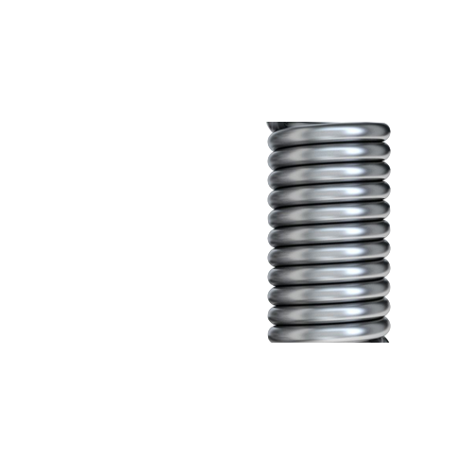
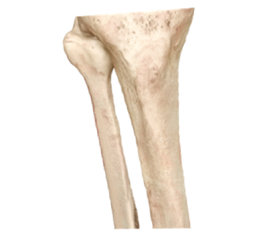

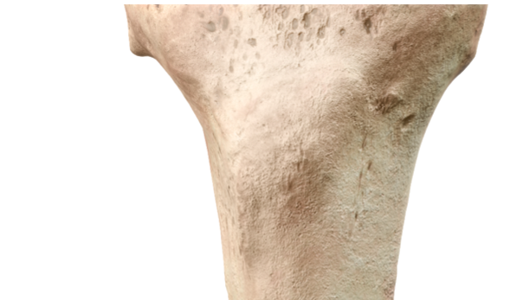
Inverse Kinematic Alignment (iKA)
Your approach suggests: Inverse Kinematic Alignment (iKA)
Restart
2.
Inverse Kinematic Alignment aims to resurface the proximal tibia back to its pre-arthritic state. The tibial resection thickness assumes the minimum tibial insert is used and is equal to implant thickness minus cartilage and bone wear. The tibia is resurfaced, and osteophytes are resected. The soft tissues of the knee are assessed using the CAS tensioner and ACCUBALANCE™ Graph before proceeding with the femoral resections. The femoral resection depth and angulations are planned in a way to balance gaps using the ACCUBALANCE Graph and obtain the intended soft tissue balance of the knee.
1.
?°

Slide 15
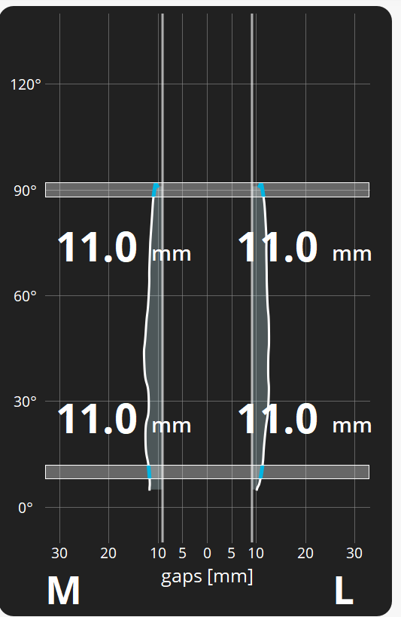
Functional Alignment (FA)
Your approach suggests: Functional Alignment (FA)
Restart
Functional alignment aims to provide balanced flexion-extension gaps. The Functional Alignment planning method enables adjustments in the coronal plane for both the distal femoral and proximal tibial resections to achieve the desired soft tissue laxity symmetry on the ACCUBALANCE™ Graph.

Slide 16
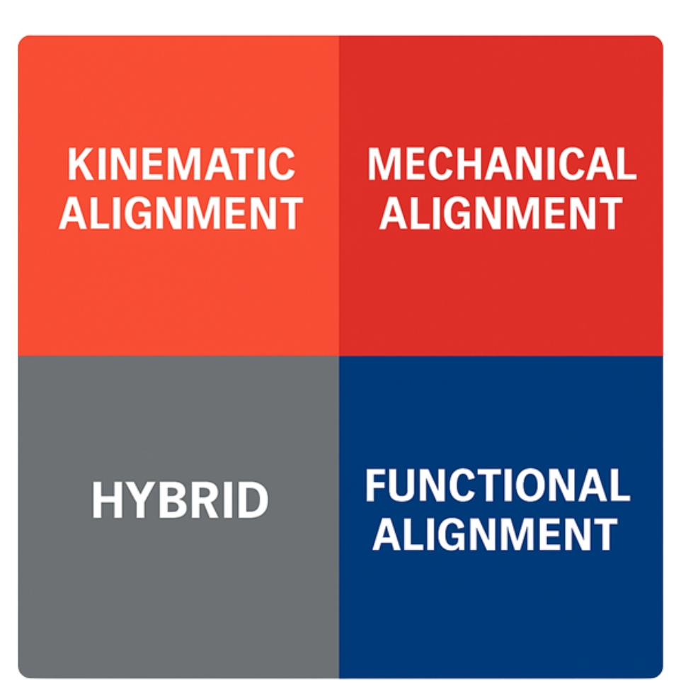
Hybrid Alignment Philosophy
Your approach suggests: Hybrid Alignment Philosophy
Restart
A Hybrid Alignment Philosophy reflects a flexible surgical approach that draws from multiple alignment strategies based on clinical judgement and procedural goals.
Notes:
Stick with Hybrid? Avoid PSA?

Slide 17
Scoring Weights
Example
Question | Choice | Resulting Score
Primary Goal | Restore native alignment | +2 KA
Willingness to Deviate | Yes | +1 KA, +1 iKA, +1 FA
Femoral Resection | Restore native joint line | +2 KA
Tibial Resection | Restore native joint line | +2 KA
Balancing Extension Gaps | Minimize femoral joint line deviation | +2 KA
Posterior Resection | Restore both medial/lateral offsets | +2 KA
Boundaries | No | +2 KA
Final Score:
KA = 13 points
iKA = 1 point
FA = 1 point
MA = 0 points
Outcome:
Strong match = Kinematic Alignment (KA)
Notes:
Highest Point Total = Suggested Alignment Philosophy
Tie?: If two philosophies are close (within 2 points), offer “Hybrid”

Slide 18
Quick-Reference Terms
MA (Mechanical Alignment): Heavily favored by neutral mechanical axis goals, mechanical cuts, minimizing tibial varus, no deviation.
KA (Kinematic Alignment): Driven by native joint line restoration, "no boundary" mindset, restore femoral & tibial JLOs.
iKA (Inverse Kinematic Alignment): Resurface tibia first, balance with femur, uses coronal boundaries, ACCUBALANCE™-driven.
FA (Functional Alignment): Focus on gap balancing, adjust both tibia/femur together, evenly distribute extension gap changes.
Hybrid Alignment: Combines features from multiple philosophies, tailoring the approach based on patient-specific factors, surgical tools, or implant systems.

Slide 19
Quick-Reference
MPTA (Medial Proximal Tibial Angle): The angle between the tibial mechanical axis and the tibial plateau surface in the coronal plane. A typical MPTA is around 87°. Deviation can influence joint line obliquity and alignment choice.
LDFA (Lateral Distal Femoral Angle): The angle formed between the femoral mechanical axis and the distal femoral joint surface in the coronal plane. A normal LDFA is around 87°. It is used to assess femoral alignment and deformities.
Tibial Mechanical Axis: A straight line from the center of the tibial plateau to the center of the ankle joint. Used to define component positioning in MA and other alignment strategies.
Femoral Mechanical Axis: A straight line from the center of the femoral head to the center of the distal femur (intercondylar notch). It helps guide component placement and alignment targets.
Long Leg Mechanical Axis: The line connecting the femoral head, center of the knee, and ankle. Used in full-length standing radiographs to assess limb alignment.
Notes:
Clickable whenever used

Slide 20
Quick-Reference
Tibial Joint Line Obliquity (TJLO): The tilt or angle of the tibial joint line in the coronal plane. Preservation of native TJLO is emphasized in KA and iKA to replicate natural knee kinematics.
Joint Line Obliquity (JLO): General term describing the angle of either femoral or tibial joint lines relative to the mechanical axis. Plays a central role in KA philosophy.
CPAK Classification (Coronal Plane Alignment of the Knee): A system that classifies native coronal alignment and joint line obliquity into nine phenotypes based on mechanical alignment and JLO. Helps personalize alignment strategies based on patient phenotype.
Sagittal Plane: Anatomical plane dividing the body into left and right sections. In TKA, sagittal plane alignment includes component flexion/extension and posterior slope of the tibial cut.
Coronal Plane: Anatomical plane dividing the body into front and back. Most alignment strategies (MA, KA, iKA) focus on alignment and joint line angles in the coronal plane.
Notes:
Clickable whenever used

Slide 21
Requests
Visual outcome chart showing how answers contributed to final classification
Horizontal Bar Graph
Radar (Spider) Chart
Should include…
Legend or color key explaining each alignment type
Callout Box with text “Your most aligned philosophy is…”
Tooltip Texts- hover over bars or points to see specific responses that contributed
Exportable PDF conclusion document (profile) and/or outcome chart
Include question regarding surgical volume (TKA), segmented by site of care
Current access to robotics?
Ability for sales consultant take notes
“Training/Demo” mode for sales consultant to explore
Embedded definitions for terminology (e.g., “joint line obliquity”
A section dedicated to questions that a sales consultant can ask a surgeon to challenge current mindset and explore Kinematic Restoration
Reference supplied word document
A section dedicated to the ATTUNE™ Knee System and how it advances Kinematic Restoration

Slide 22
Requests
Point system running in the background
User interface remains conversational and guided
Allows for subtle segregation of preferences
Flexible interpretation to accommodate hybrid tendencies
Data driven determination of aligned philosophy
Admin Dashboard
See trends in surgeon alignment preferences across regions
Identify training needs/locations
Clinical Evidence Pop-Ups
Compare Philosophies Tool
Allow users to compare 2-3 philosophies side by side
Interactive glossary
Hover-based or tap-enabled terms
Diagrams or animations
Mobile first mindset!

Slide 23
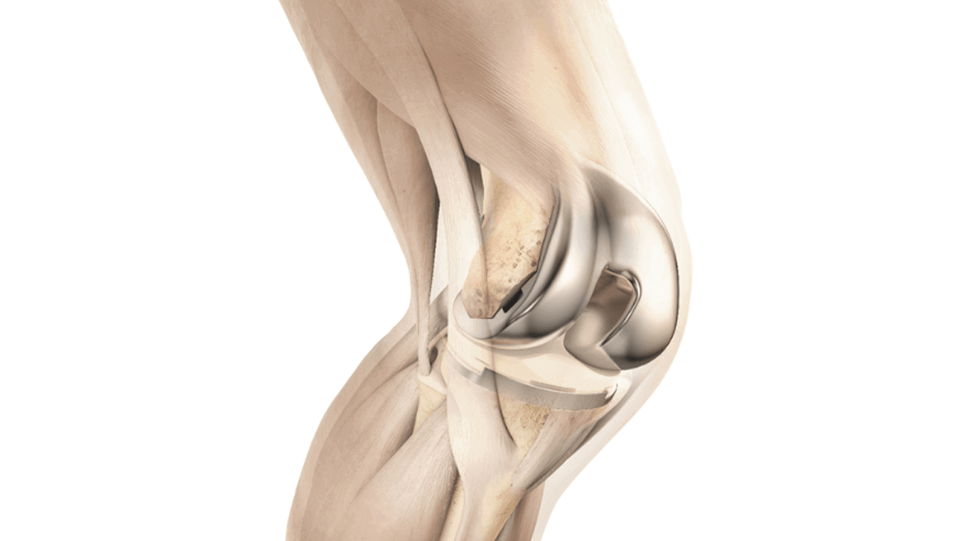

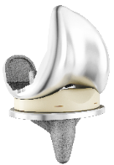
Images
ATTUNE™ Knee System

Slide 24
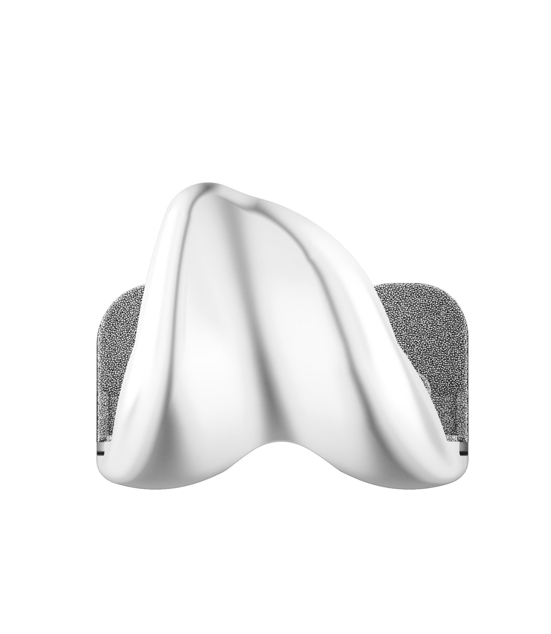
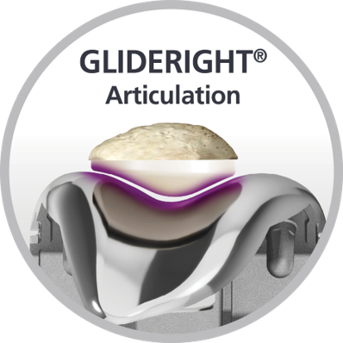
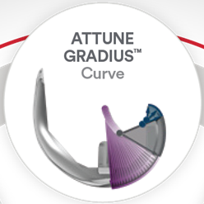
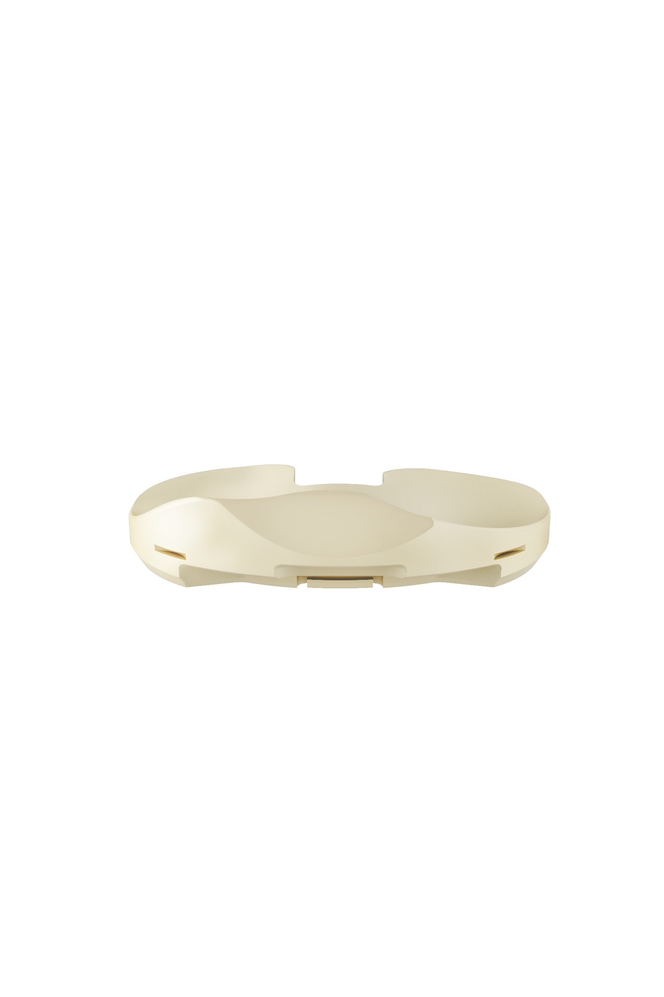
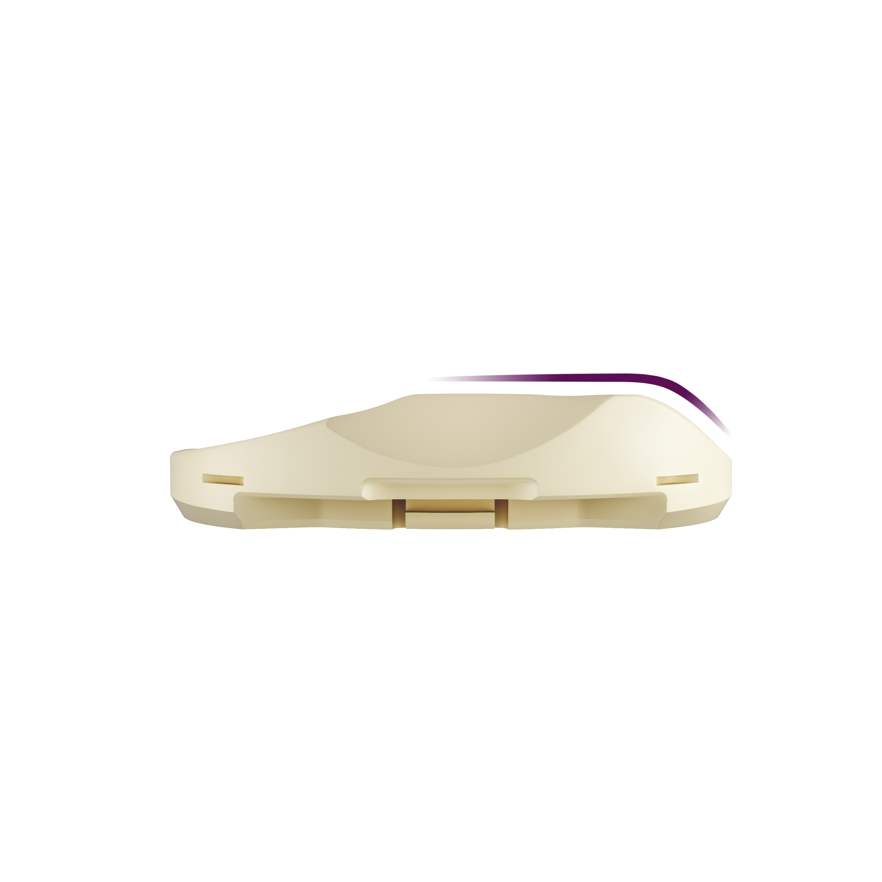
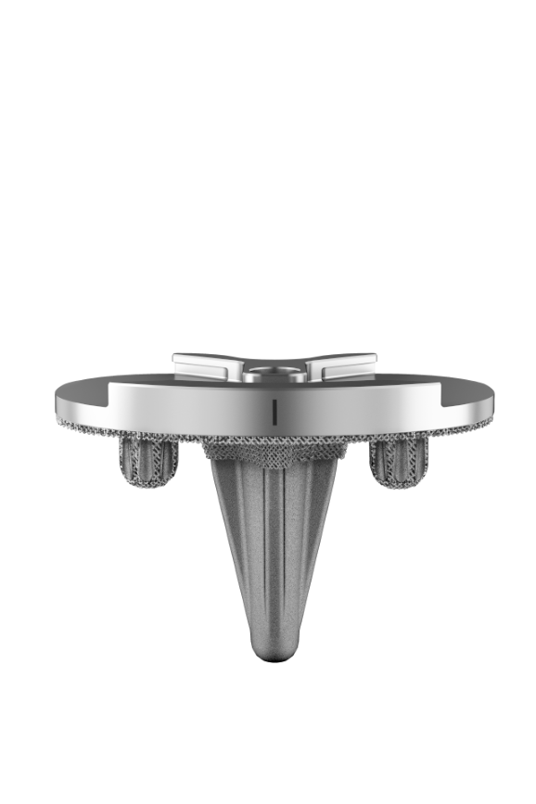
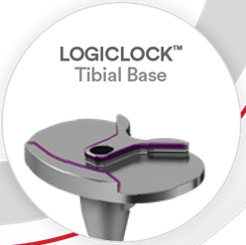
ATTUNE System Kinematically Advanced Implant
Medial Stabilized
Insert
Patellofemoral Articulation
Patellofemoral geometry accommodates variation in trochlear orientation required for kinematic techniques
Femoral Geometry
Gradually reducing femoral radius for smooth transition throughout the gait cycle
Tibio-femoral conformity from extension to flexion
Appropriately tension the MCL throughout full ROM
Medial Stabilized
Insert
Optimal tibiofemoral articulation
Central locking mechanism provides the architecture for 1:1 articulation match between femoral component and tibial insert every time
Medial Stabilized Insert
Improved Medial Conformity to provide stable TKA experience
Reduced Lateral Conformity to enhance normal knee motion
Versatile to support multiple surgical philosophies
1. DePuy Synthes, Forward Dynamics Modeling Analysis: Multi-Patient Verification Report, SEA103845908, Adaptive, 2021. 2.Johal et al- Tibio-femoral movement in the living knee. A study of weight bearing and non-weight bearing knee kinematics using ‘interventional’ MRI Journal of Biomechanics 38 (2005) 269–276 3. DePuy Synthes ATTUNE Fix Bearing Knee, IFU 0902-00-902 Rev B. 4. Dalury D. ATTUNE® Knee System” ATTUNE GRADIUS® Curve. White Paper. DPS 149671-200812 DSUS. 5. Leisinger, S.Advanced fixed bearing TKA locking mechanism minimizes backside micromotion. International Society for Technology in Arthroplasty (ISTA) Annual Meeting. 2011.
Notes:
1. DePuy Synthes, Forward Dynamics Modeling Analysis: Multi-Patient Verification Report, SEA103845908, Adaptive, 2021. 2.Johal et al- Tibio-femoral movement in the living knee. A study of weight bearing and non-weight bearing knee kinematics using ‘interventional’ MRI Journal of Biomechanics 38 (2005) 269–276 3. DePuy Synthes ATTUNE Fix Bearing Knee, IFU 0902-00-902 Rev B. 4. Dalury D. ATTUNE® Knee System” ATTUNE GRADIUS® Curve. White Paper. DPS 149671-200812 DSUS. 5. Leisinger, S.Advanced fixed bearing TKA locking mechanism minimizes backside micromotion. International Society for Technology in Arthroplasty (ISTA) Annual Meeting. 2011.

Slide 25
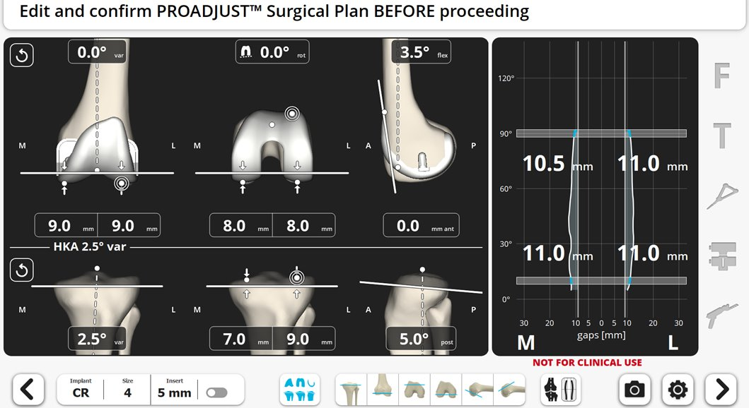
Inverse Kinematic Alignment ProAdjustTM Planning
Systematic Planning Process
1
Proximal Tibia Resection Depth
Recreate Medial Proximal Tibial Angle (MPTA)
Soft-tissue ACCUBALANCE Graph
Initial priority when balancing femur post tibia resection
HKA (Long Leg Alignment)
HKA target/boundary
Distal Femoral Resection Depth
Target recreating LDFA or matching resection depth to component thickness
Medial Posterior Femoral Condyle Resection Depth
Target resection depth to match resection depth to component thickness
2
4
5
3
4
3
1
2
5

Slide 26
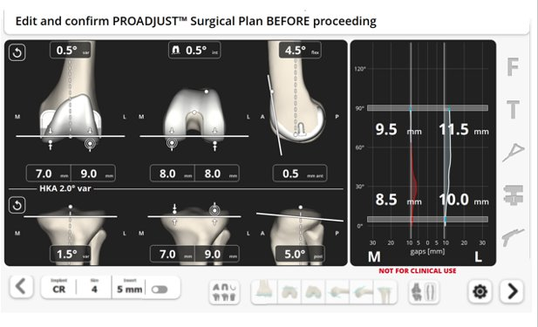
Kinematic Alignment ProAdjustTM Planning
Systematic Planning Process
Distal Femoral Resection depth
Recreate Lateral Distal Femoral Angle (LDFA)
Posterior Condyle Resection Depth
Resurface posterior femoral condyles
Proximal Tibia Resection Depth
Recreate Medial Proximal Tibia Angle (MPTA)
ACCUBALANCE Graph
Utilize soft-tissue data if boundaries are used
HKA (Long leg Alignment)
Utilize HKA target if boundaries are used
1
2
4a
1
2
3
4b
4a
3
4b

Slide 27
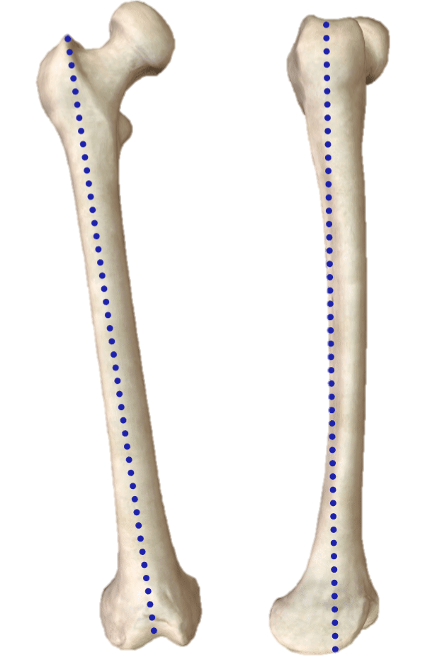
Femoral Anatomic Axis
Femoral Mechanical Axis

Slide 28
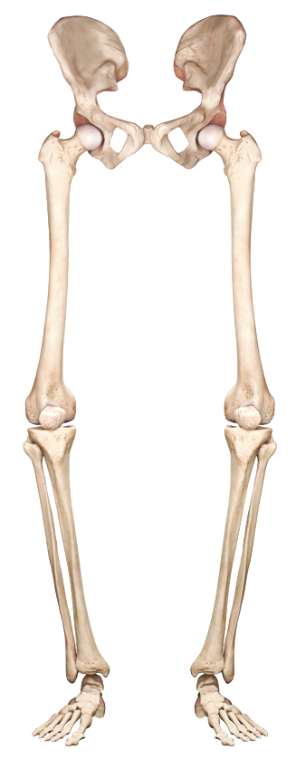
FEMORAL MECHANICAL AXIS
FEMORAL ANATOMICAL AXIS
HKA (HIP, KNEE, ANKLE) ANGLE
LONG LEG MECHANICAL AXIS
TIBIA MECHANICAL AXIS
TIBIA ANATOMICAL AXIS

Slide 29
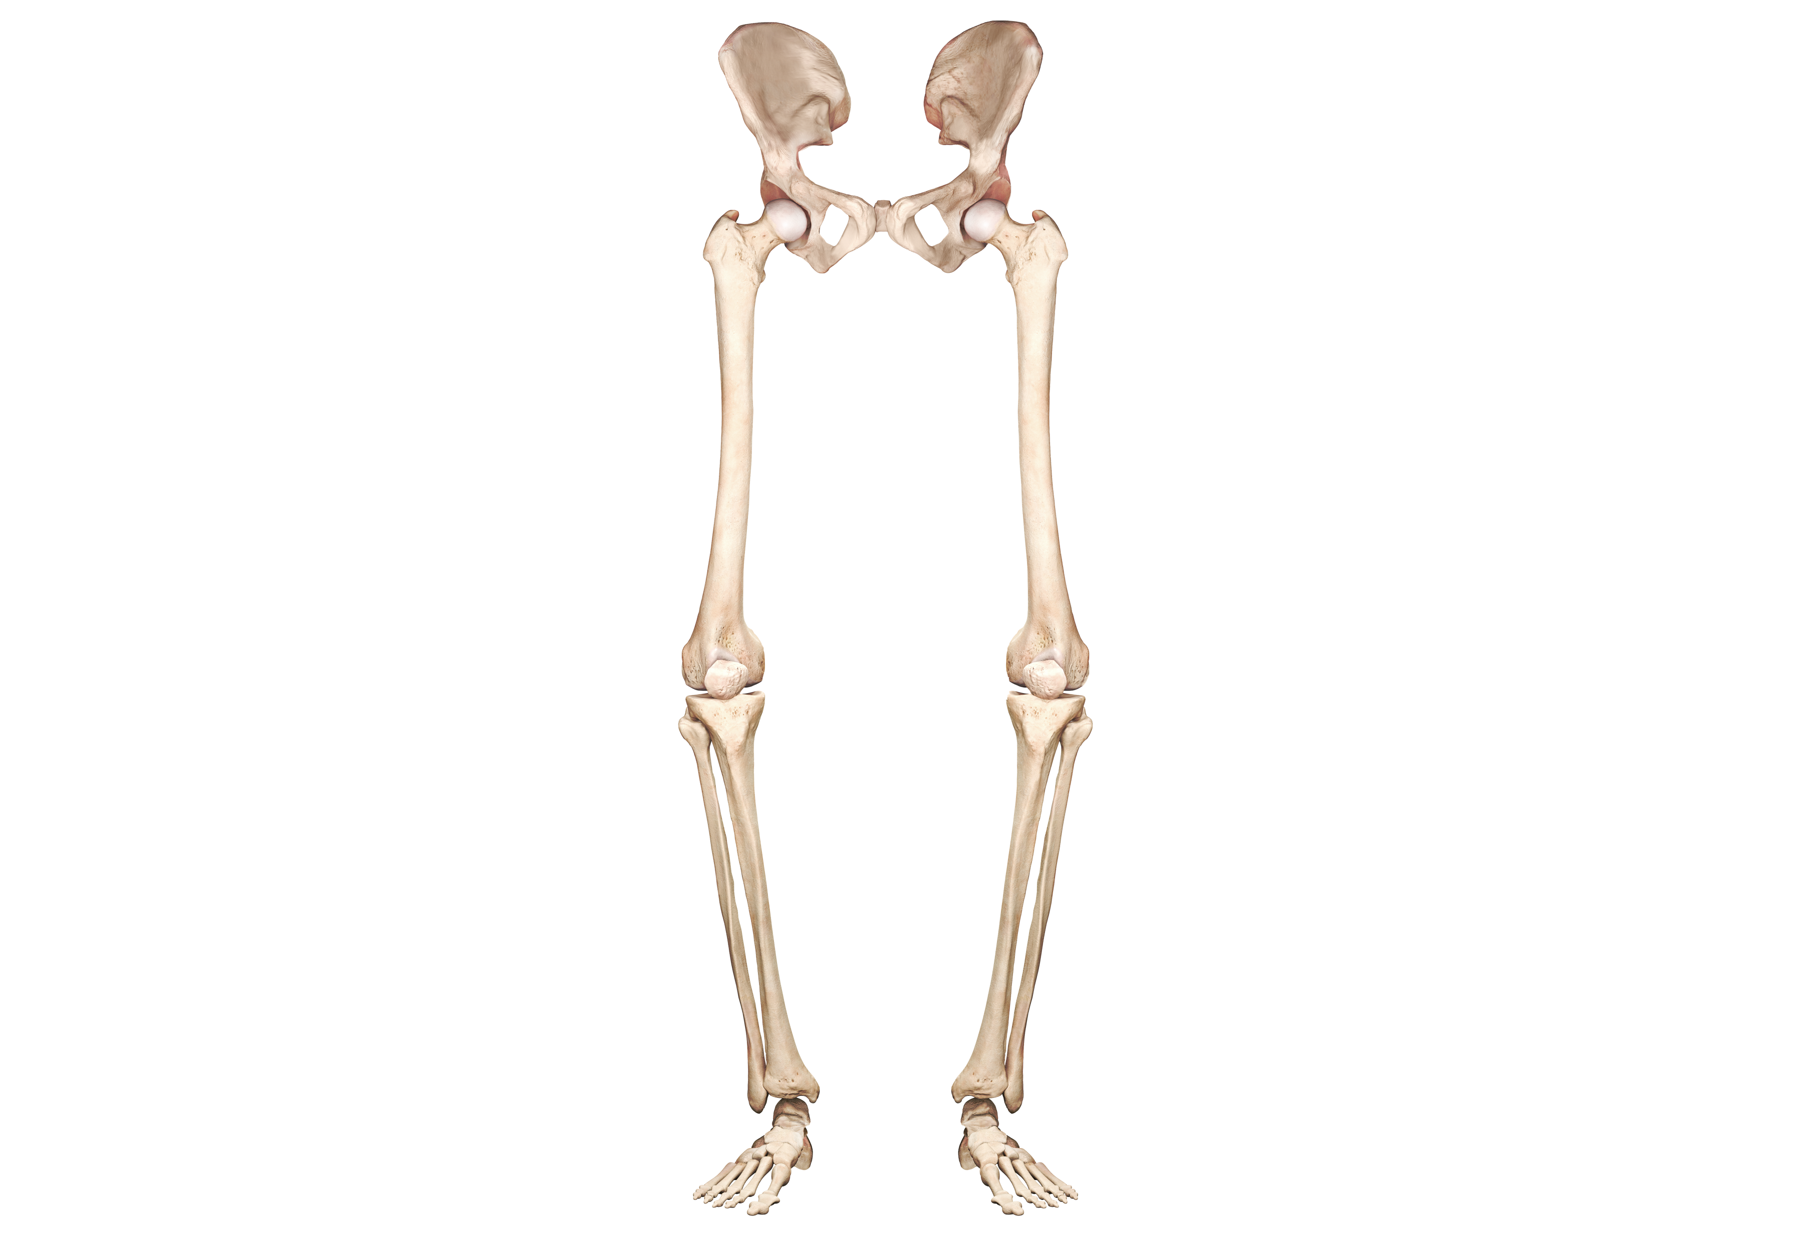
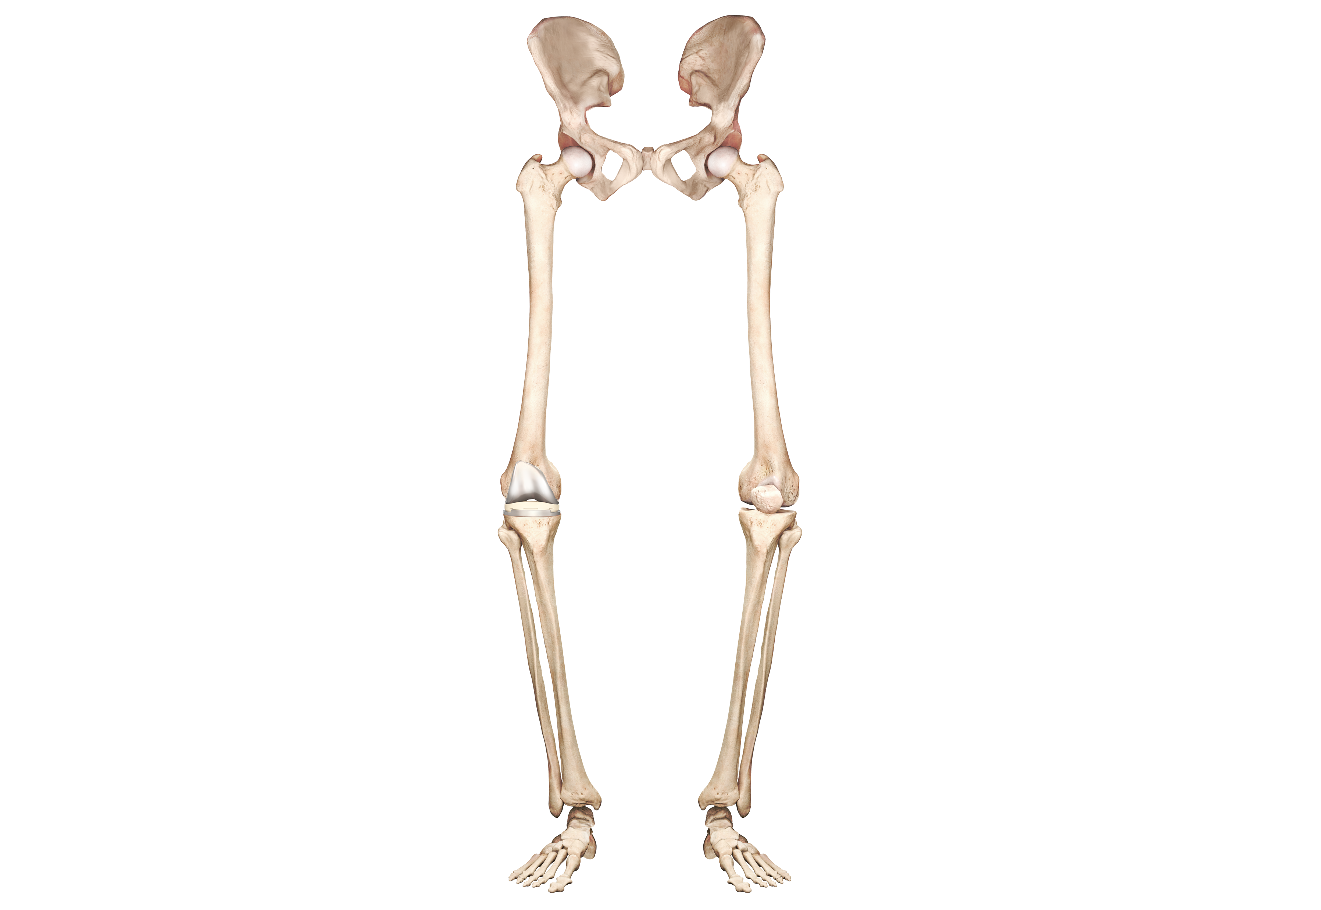
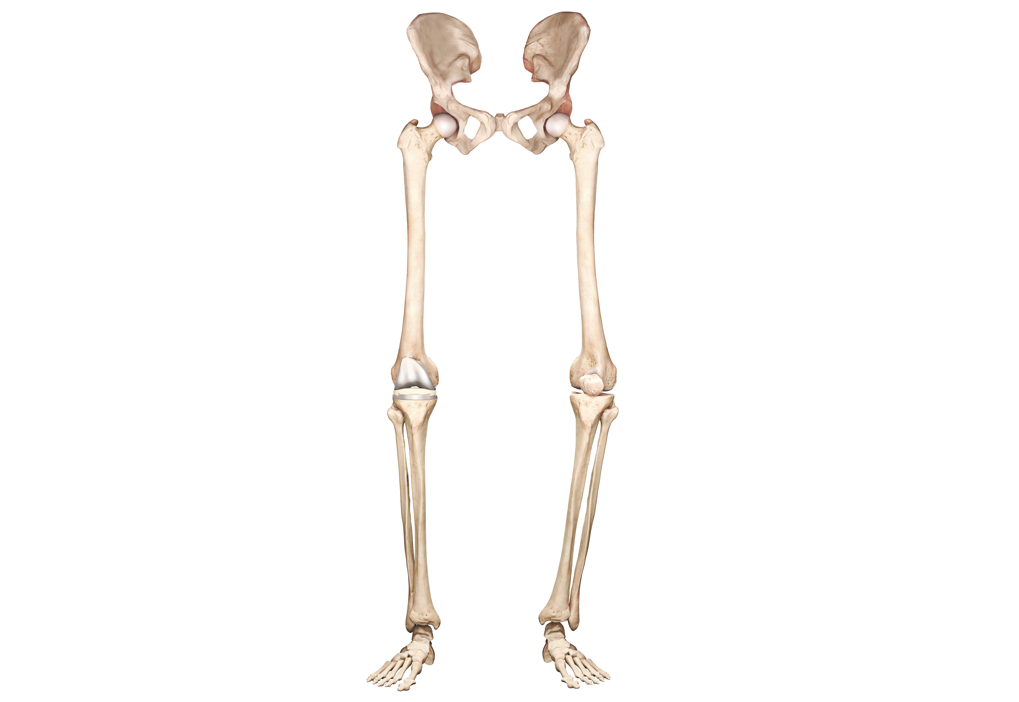
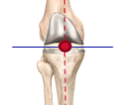
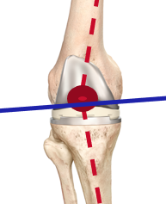
(1) Overall (HKA) Alignment
(2) Joint Line (JL) Orientation
Mechanical Alignment
Kinematic Alignment
VARUS
STRAIGHT
VALGUS

Slide 30
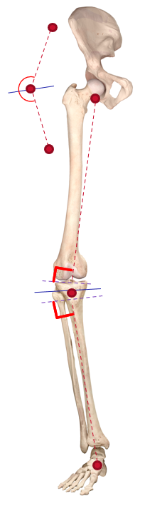
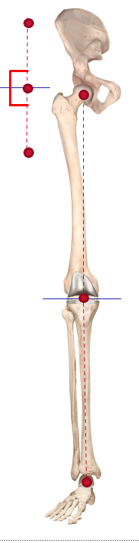
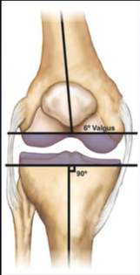
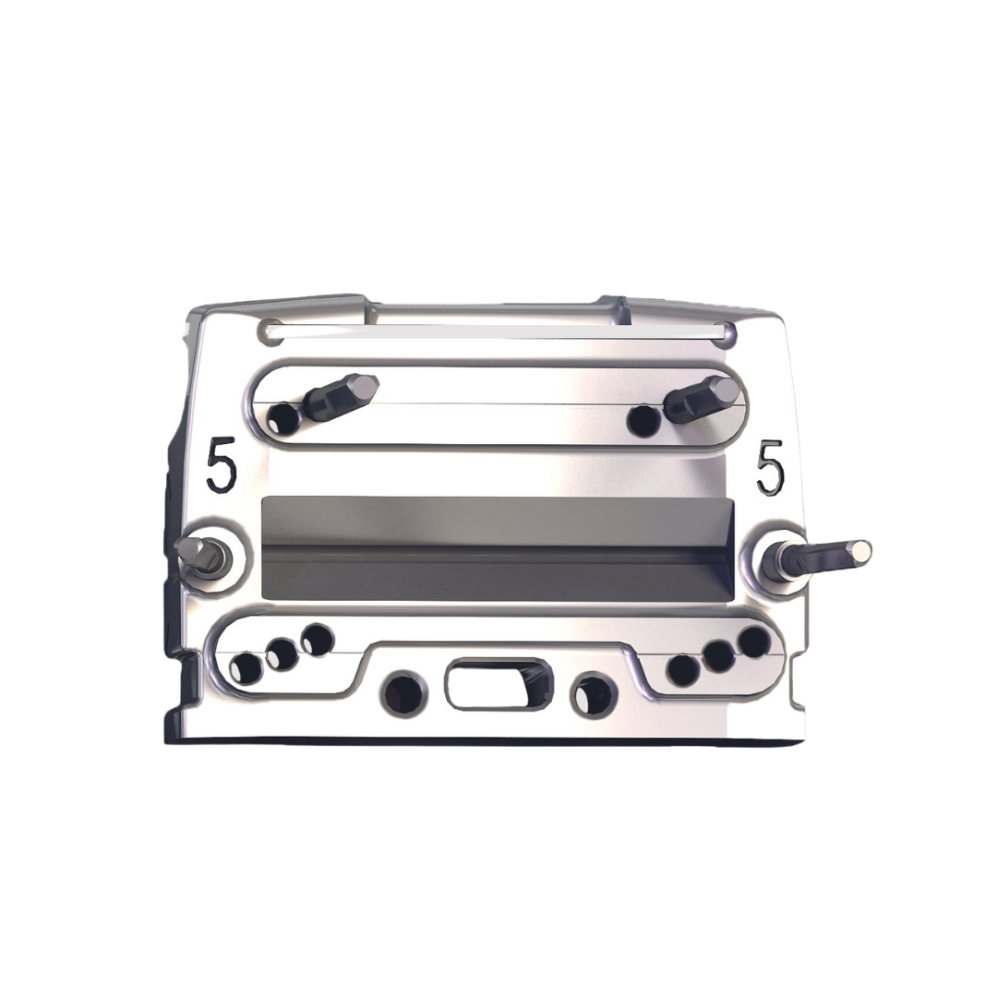
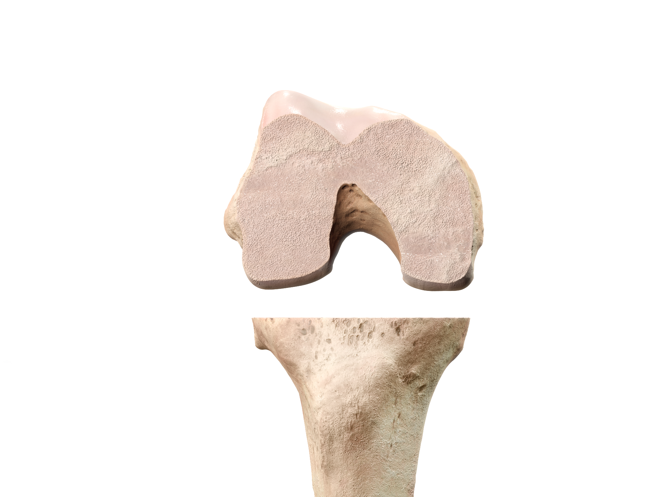
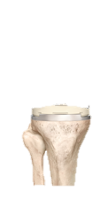
Mechanical Alignment
Mechanical Alignment: - Straight Leg -Neutral Mechanical Joint Line (Resections)
Mechanical Alignment
Whiteside’s Line
Transepicondylar Line
3˚
Posterior Condylar Line
90˚
HKA 177°
HKA 180°
Unequal Resections

Slide 31
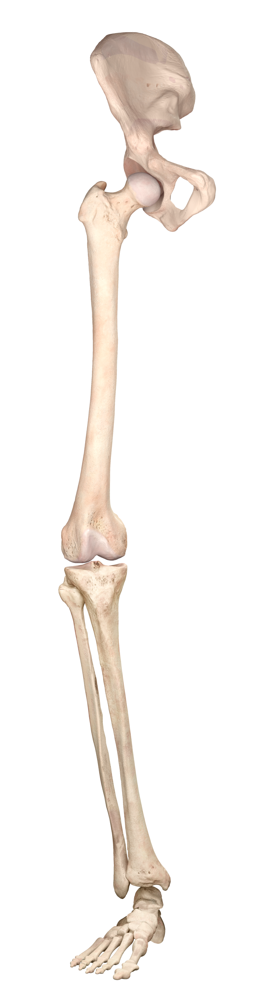
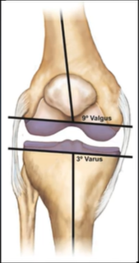
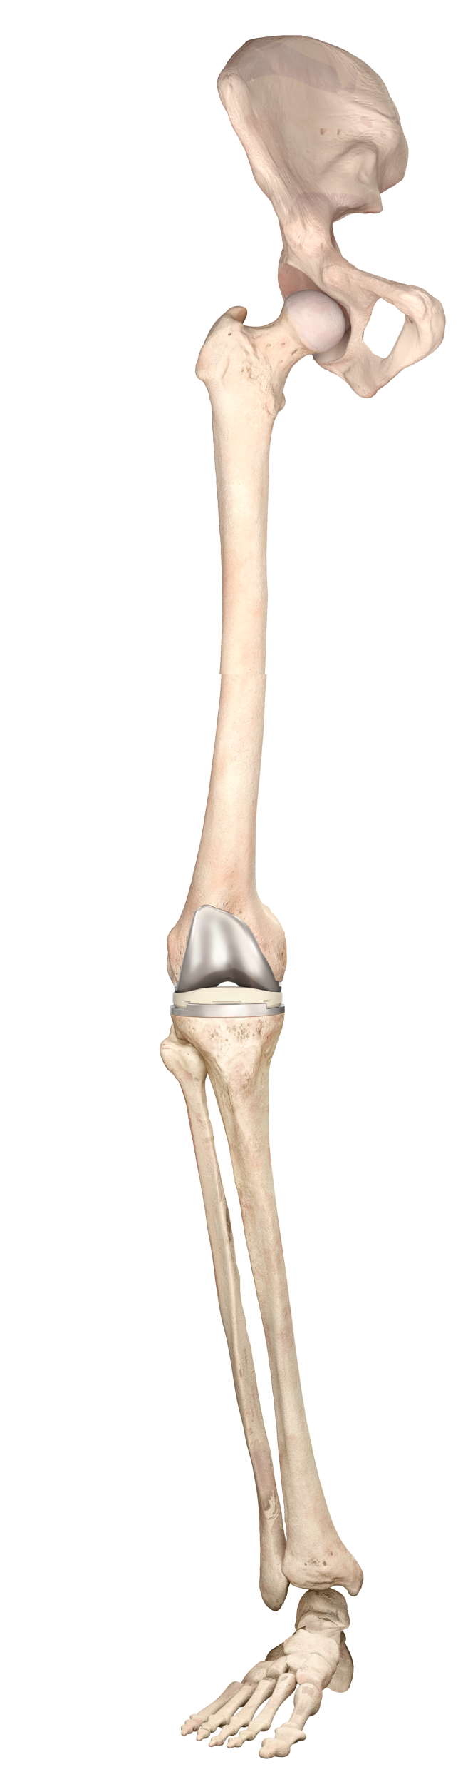
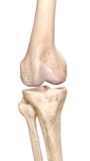
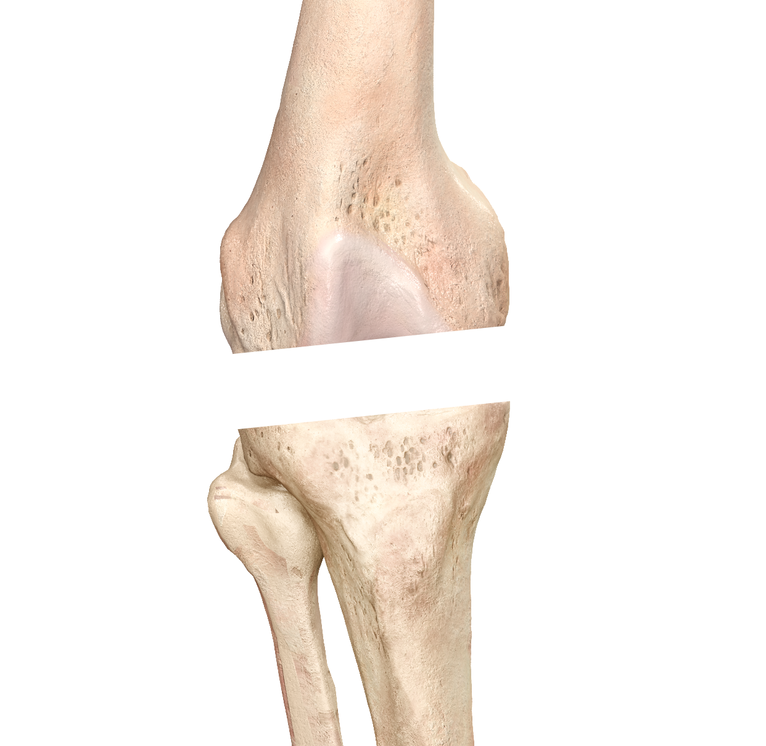
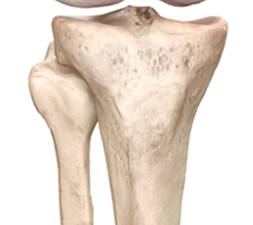
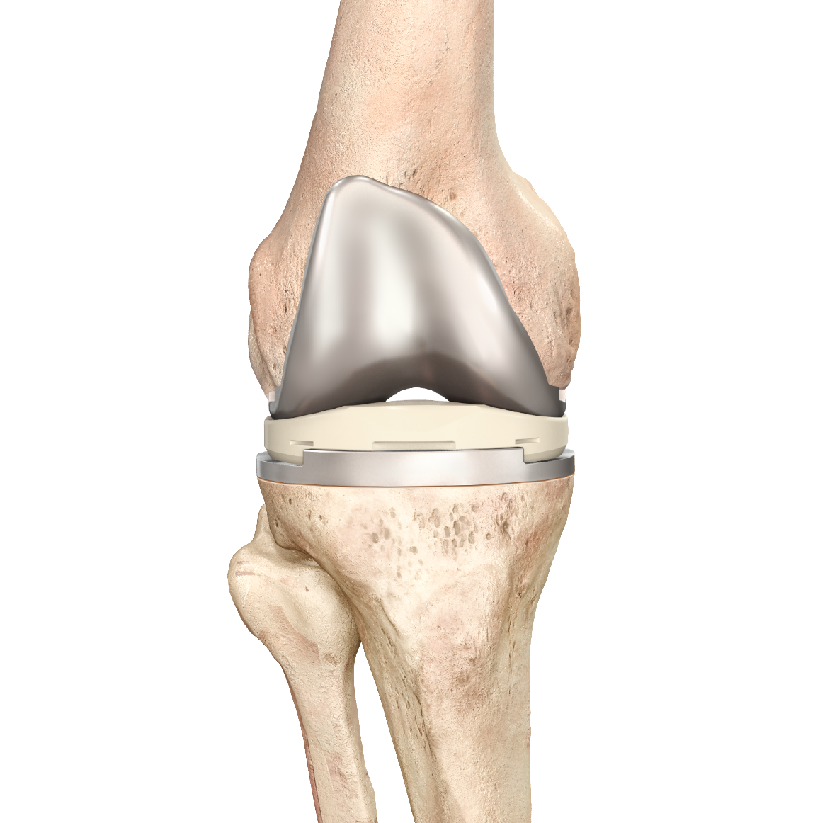
Resections made equal to native anatomy
Equal medial and lateral bone resections
HKA and Joint Line orientation does not change
Kinematic Alignment
Kinematic Alignment
Equal Resections

Slide 32
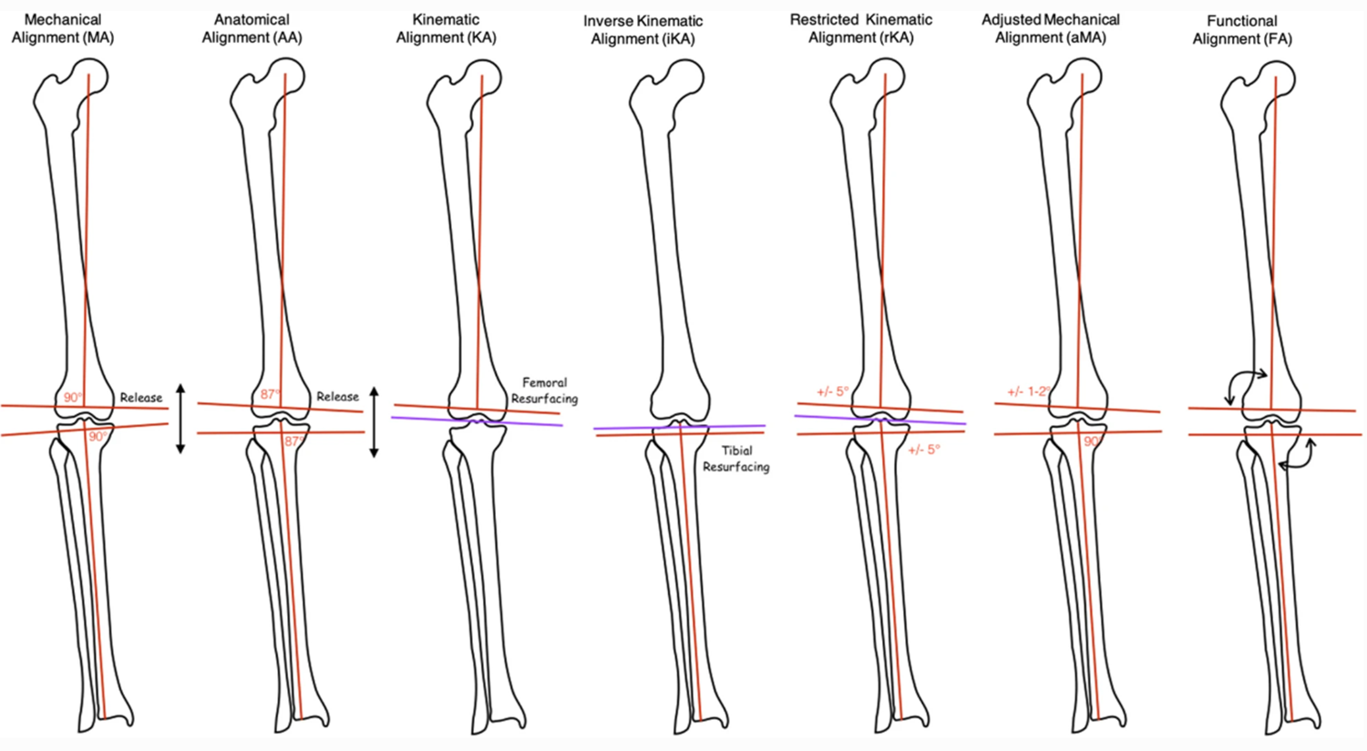


Slide 36
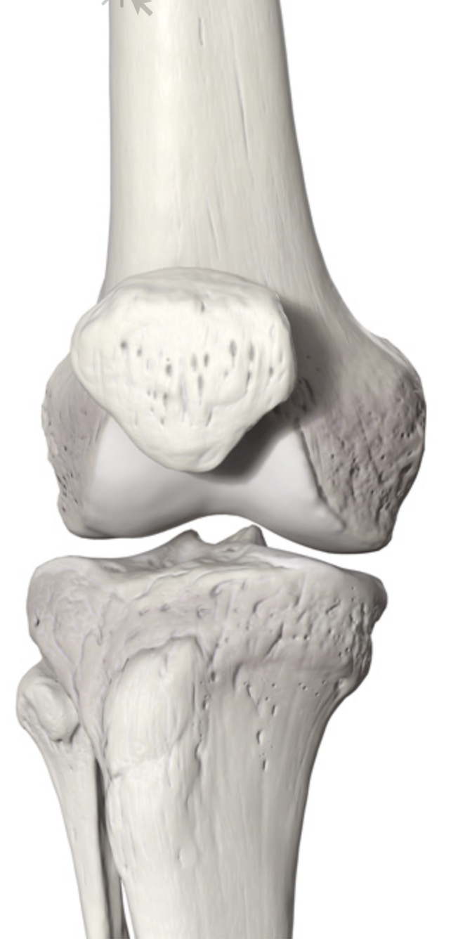
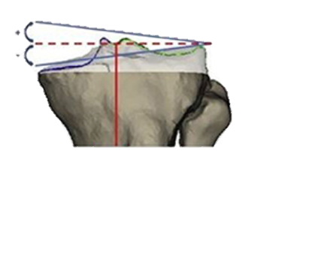
L
M
HKA
87º
MPTA
MPTA
Medial Proximal Tibial Angle
Mean 2.9⁰ Varus
Range: 20.5⁰ Valgus – 20.5⁰ Varus
Tibial Mechanical Axis

Slide 37
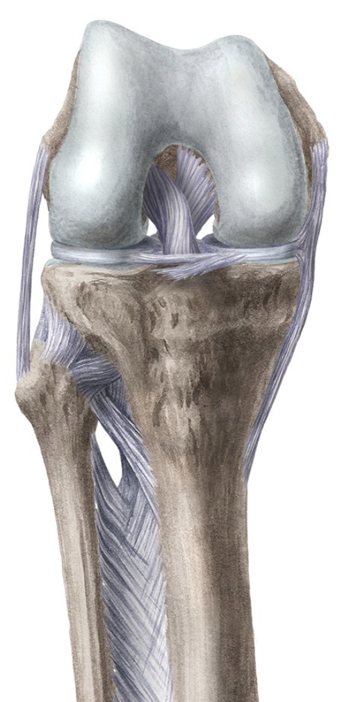
Femoral Mechanical Axis
LDFA
Lateral Distal Femoral
Angle
87º

Slide 38
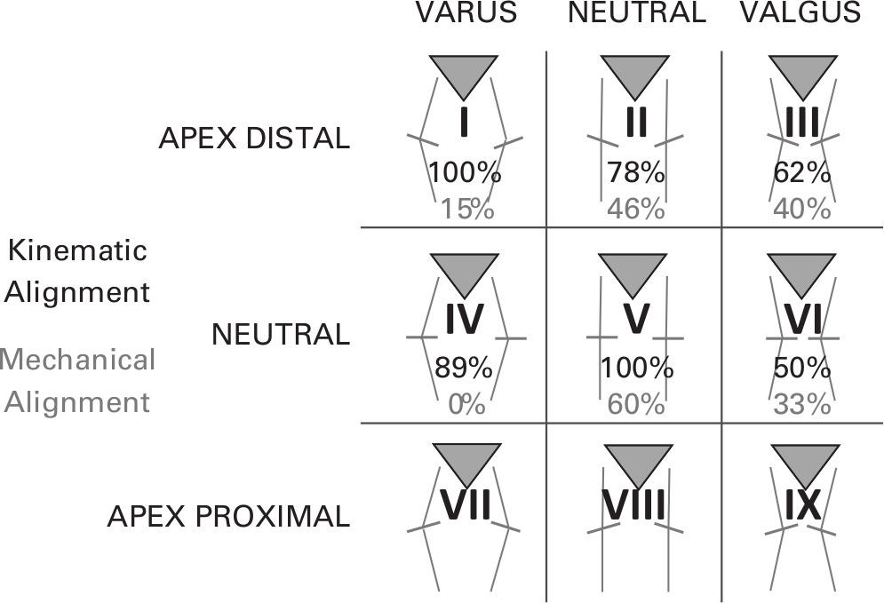
CPAK

Slide 39
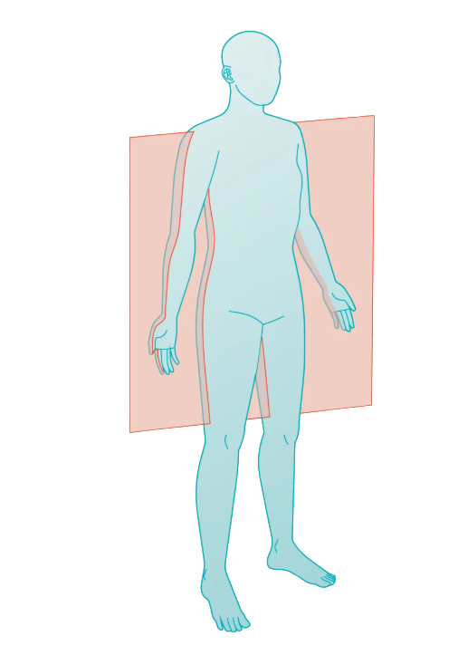
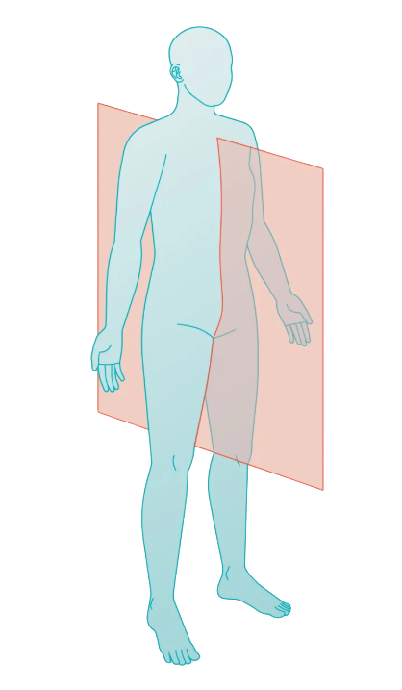
Coronal
Sagittal

